Slide 1
C程式設計實驗(二)
Chapter2. Function Basics

Slide 2
Outline
Predefined Functions
Programmer-Defined Functions
Defining, Declaring, Calling
Recursive Functions
Scope Rules
Local variables
Global variables

Slide 3
Predefined Functions
void function
E.g. exit(1);
Argument value returned : Function_Name(Argument_List)
E.g. sqrt(a);
pow(a, b);
// this call terminates program
// square root, sqrt(4.0) = 2.0
// powers, pow(2.0, 3.0) = 8.0

Slide 4
Predefined Functions
#include <header_file>
E.g. #include<cmath>
#include<cstdlib>
#include<iostream>

Slide 5
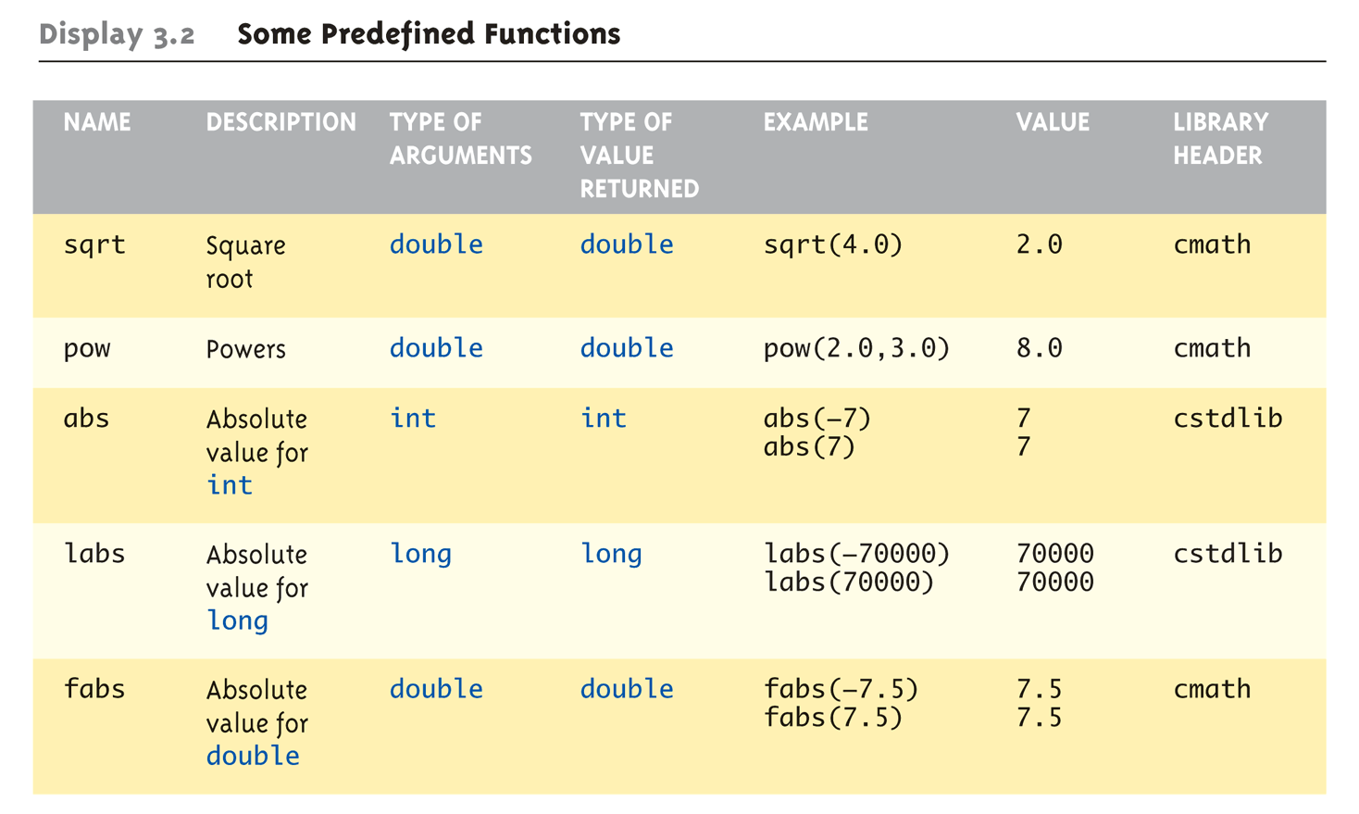

Slide 6
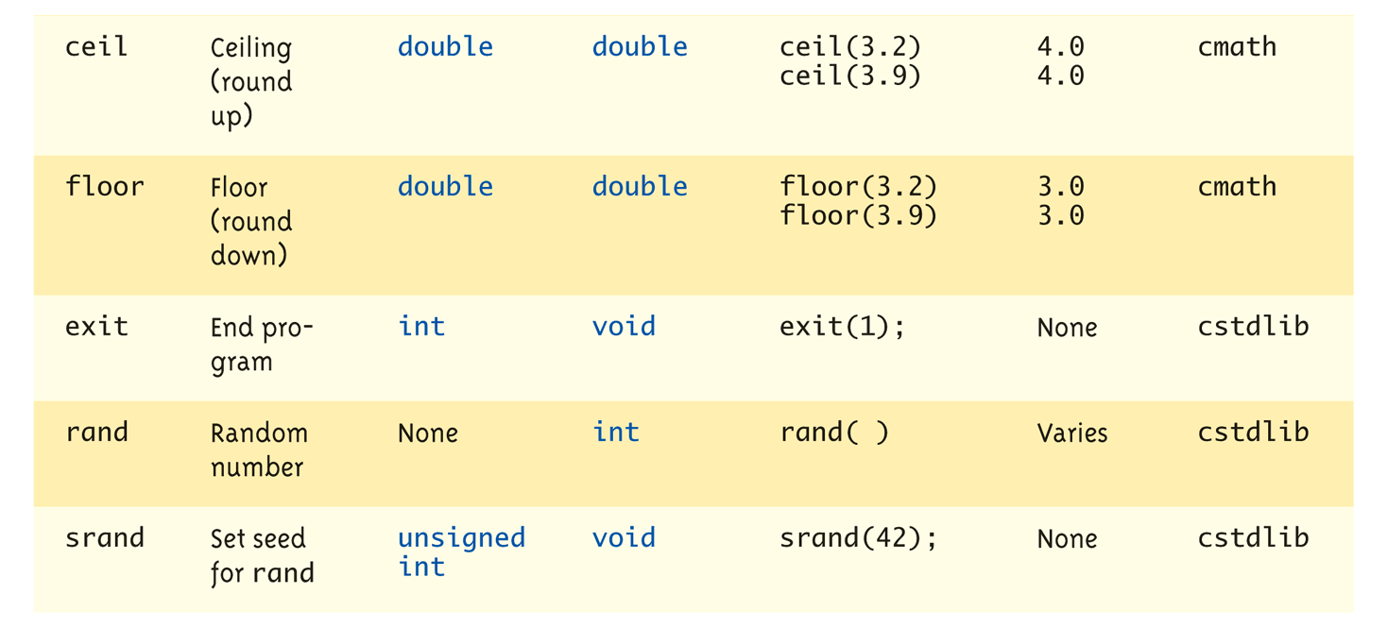

Slide 7
Programmer-Defined Functions
Building blocks of programs :
Divide & Conquer
Readability
Re-use

Slide 8
Programmer-Defined Functions
３ parts to using Functions:
Function Declaration
Function Definition
Function Call

Slide 9
Function Declaration
Called “Function prototype”
Tell compiler how to interpret calls
E.g. double totalCost(int number, double price);
Placed before any calls
In declaration space of main()
Above main() in global space

Slide 10
Function Definition
Implementation of function
Placed after function main(), NOT “inside” main()!
E.g.
double totalCost(int number, double price){
double TAXRATE = 0.05;
double subtotal;
subtotal = price * number;
return(subtotal + subtotal * TAXRATE); //return: send data back to caller
}

Slide 11
Function Call
Just like calling predefined function
E.g. bill = totalCost(num, pric);
Argument here: num, pric
Recall arguments can be literals, variables, expressions or combination

Slide 12
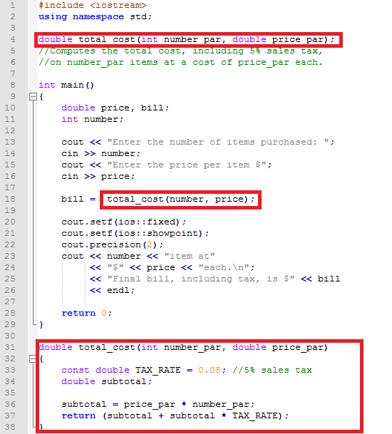
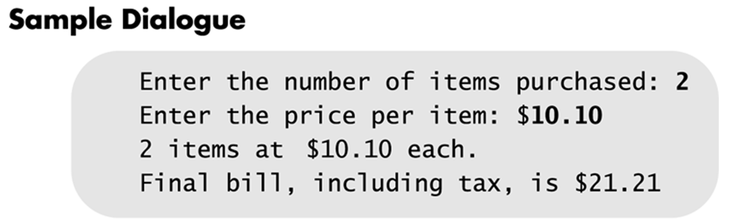
function declaration
function call
function heading
function definition
function body

Slide 13
Scope roles
Local Variables
Global Variables

Slide 14
Local Variables
Declared inside the body of the given function
Available only within that function
Can have variables with the same names declared in different functions

Slide 15
Global Variables
Declared “outside” function body
Global variables are dangerous: no control over usage!
Global declarations typical for constants
E.g. const double TAXRATE = 0.05;

